Slide 1
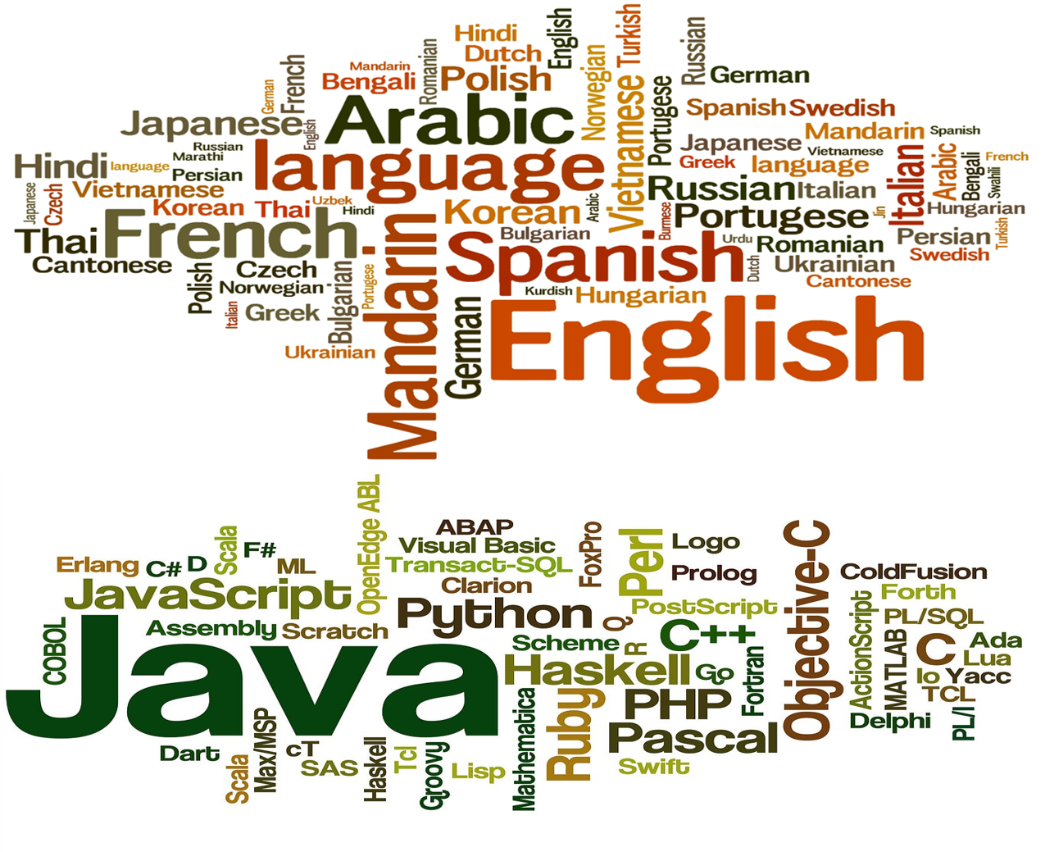
Life and Death
-Natural Languages vs. Programming Languages-
Composed By: Hayato Ishida
For Japanese version, click here
Updated On: 16 July 2024

Slide 2
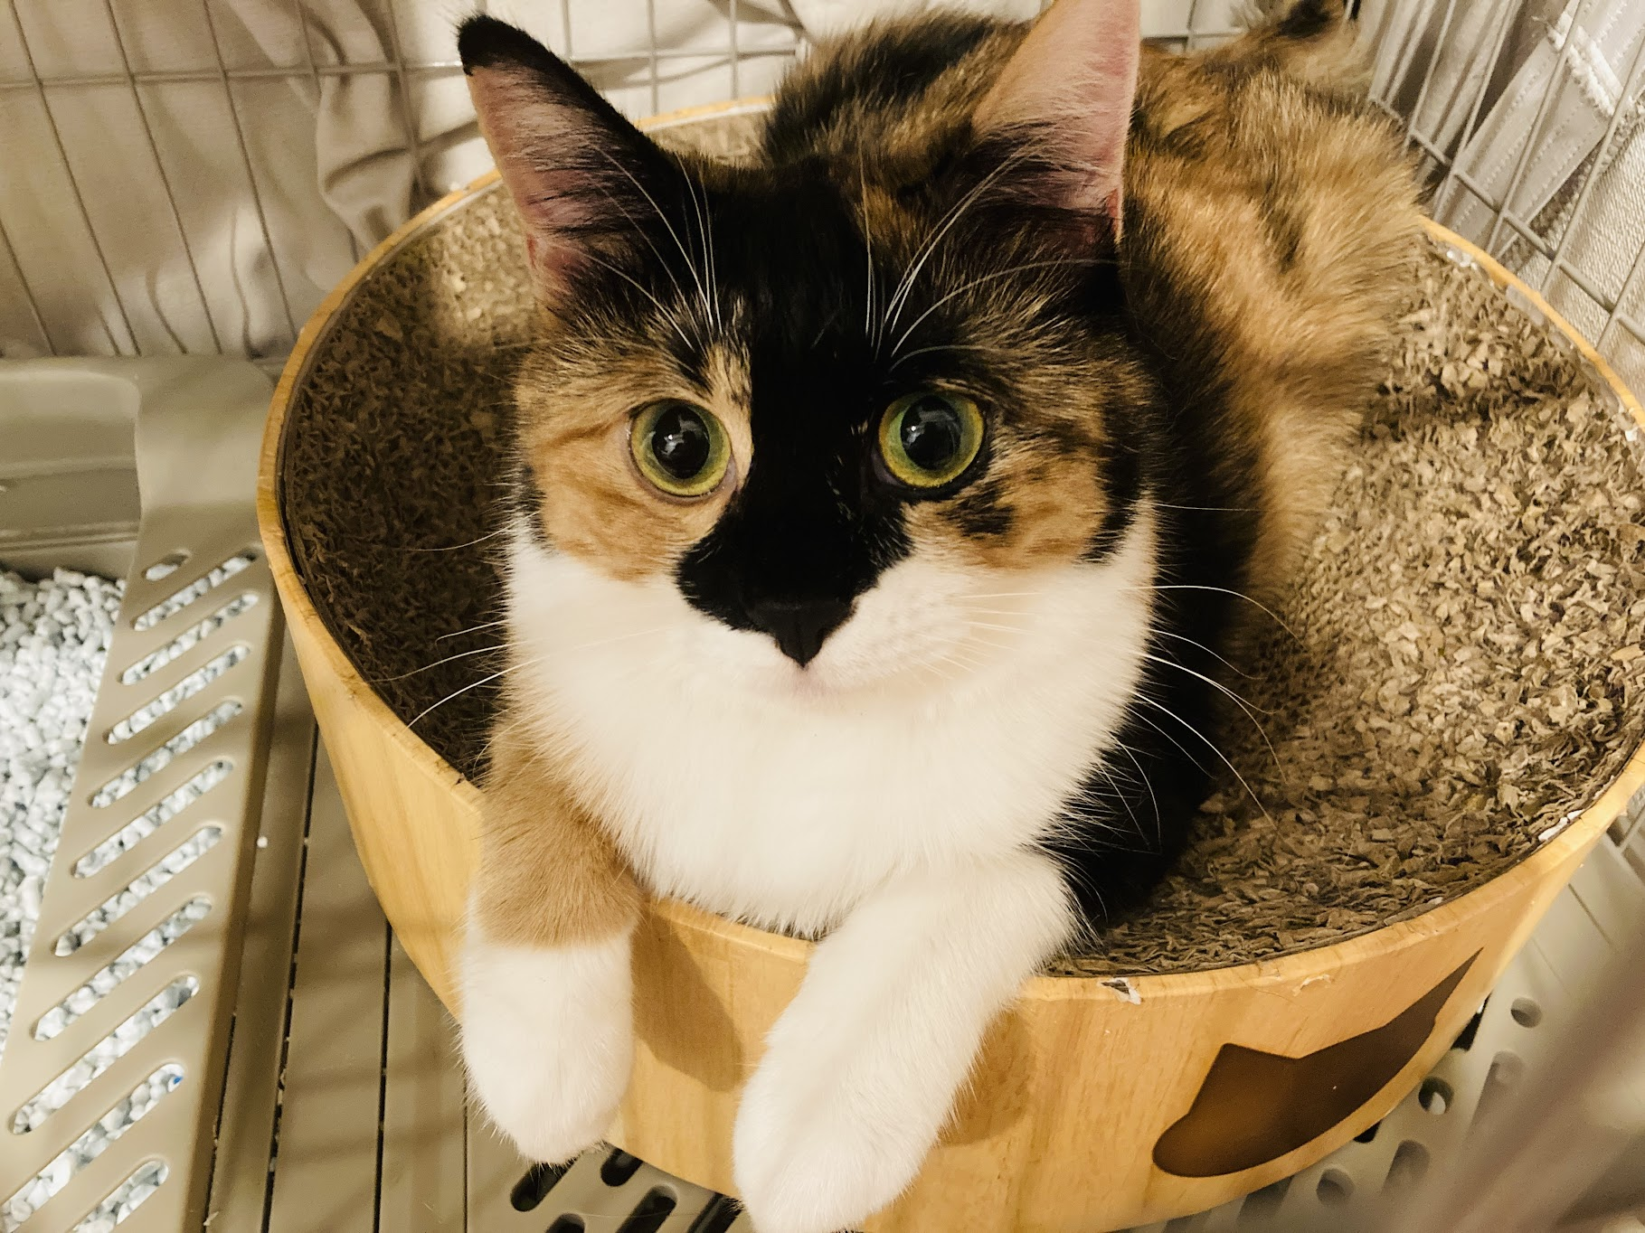
About Me
Accounts
GitHub: @hayat01sh1da
X: @hayat01sh1da
LinkedIn: @hayat01sh1da
Speaker Deck: @hayat01sh1da
Docswell: @hayat01sh1da
Occupation: Software Engineer
Things I Am Into
Linguistics
Singing at Karaoke
Listening to Music
Watching Movies
Cat Feeding

Slide 3
Licences / Certifications
English
TOEIC® Listening & Reading 915: Certified on December 2019
Engineering
Information Security Management: Certified on November 2017
Applied Information Technology Engineer: Certified on June 2017
Fundamental Information Technology Engineer: Certified on November 2016
IT Passport: Certified on April 2016
Others
Abacus 2nd Class: Certified on June 2002
Mental Arithmetic 3rd Class: Certified on February 2001

Slide 4
Skill Stack
Languages
Japanese: Native Proficiency
English: Full professional Proficiency
Development
Backend: Ruby(Ruby on Rails), Python
Frontend: TypeScript + React.js, TypeScript +Vue.js
Database: MySQL, PostgreSQL, MongoDB
Architecture: Monolith, Modular Monolith
Hosting: AWS ESK
Versioning: Git, GitHub
CI/CD: GitHub Actions, ArgoCD
Monitoring: Datadog, Sentry

Slide 5
Work Histories
Period | Genre | Position | Jobs
Aug 2021 - Present | Saas(Educational Service) | Software Engineer | Backend Development Frontend Development CI/CD Maintenance Weekly Release Manager Troubleshooting Documentation Technical Debt Resolution Tech Blog Entries LT Speaker
Feb 2020 - Dec 2020 | SaaS(Chatbot Platform) | Backend Engineer | Backend Development Documentation Technical Debt Resolution Inspection of Alternative API

Slide 6
Work Histories
Period | Genre | Position | Jobs
Jun 2018 - Jan 2020 | Contract-basis Developer | Software Engineer | Backend Development Frontend Development Troubleshooting Quality Assurance Tech Blog Entries
Apr 2016 - Jan 2018 | System Engineering Service | System Engineer | Corporate Account Admin Windows Server Maintenance Security Admin Assistant Internationalisation / Localisation

Slide 7
International-Exchange Activities
Activities in University
English Linguistics Seminar(Focusing on Mass Media English)
International-Exchange Clubs(The 2nd Year)
International-Exchange Programmes conducted by Japan Cabinet Office(2013 - 2016)
Japanese Linguistics Course(The Final Year)
Overseas Life Experience
Working Holiday in Australia(April 2014 - March 2015)
Language School for 1 month in Sydney
Work for 6 Months in Hamilton Island Resort
Volunteering for 1 Month as Assistant Teacher of Japanese Language at St Ives High School in NSW
Other Activities
Keep Everyday Journal in English (April 2014 - Present)
Sunrise Toastmasters Club(February 2017 - March 2018)
Vital Japan(January 2018 - July 2019, October 2022 - February 2023)
Self Learning and Training of English Language
Participation Ruby-Related Tech Conferences

Slide 8
The Main Theme
I would love to share the following 3 interesting point of views to compare Natural Language with Programming Language, whose objectives, purposes and usages are totally different.
What is the definition of Live Languages?
What is the definition of Dead Languages?
What a dead language brings about?

Slide 9
The Theme out of Scope
The Details of English Language (Words, Idioms, Grammar, Pronunciation etc.)
The Details of Linguistics(History, Acoustics etc.)
The Details of Programming Languages(Mechanisms, History, Implementation etc.)

Slide 10
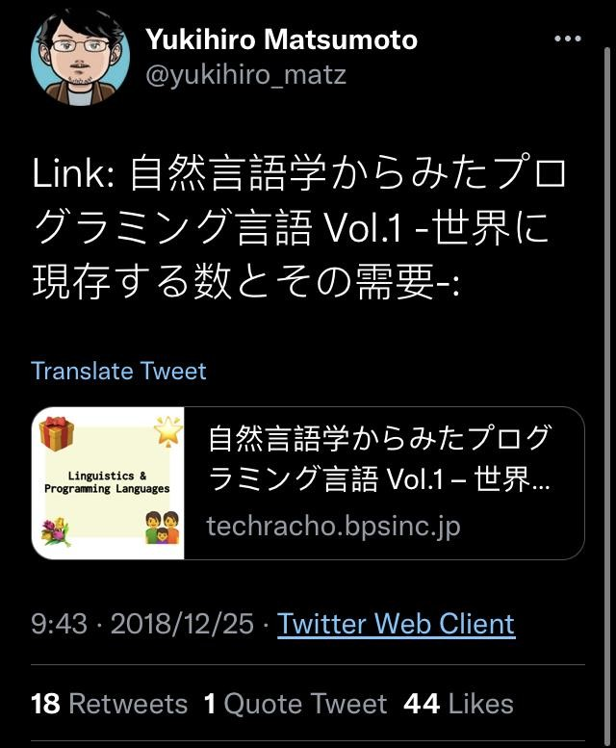
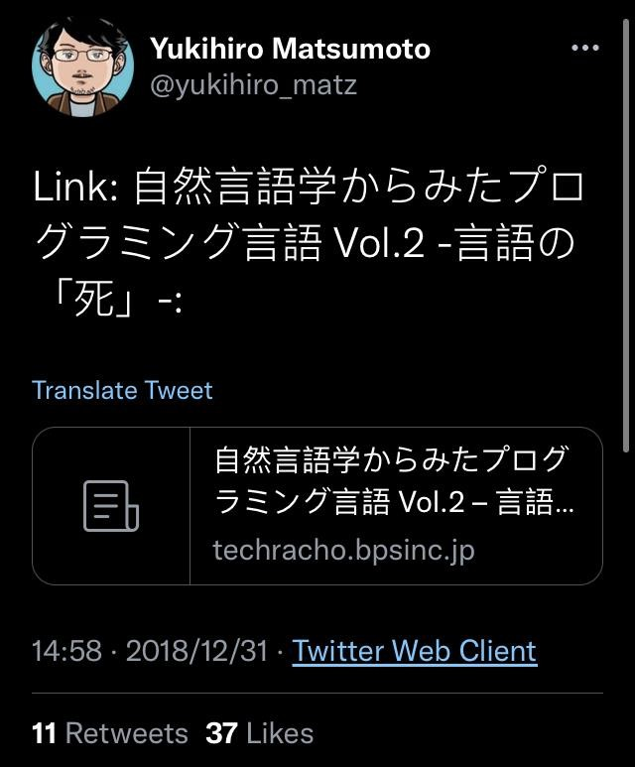
The Original Material
The following articles as Advent Calendar 2018 in the 2nd Company
Matz(The Father of Ruby) retweeted them as follows

Slide 11
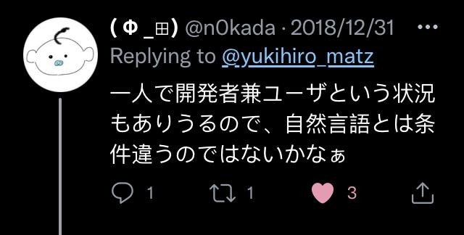
Discussions Are Welcomed!!

Slide 12
Agenda
Representative Features of Each Language
Definition of Life and Death
Effects Caused by Death
Summary
References

Slide 13
1. Representative Features of Each Language

Slide 14
1. Representative Features of Each Language
Natural Languages
Naturally Born
Not artificially invented
Used as both Written and Spoken
Formal and Casual
Living Standard
Always changing and evolving
Categorised by period like English language as Old English, Middle English, Modern English and Present-day English
Reflection of Societies, Cultures, Histories and People who Deal with them
Communication Tool
Exchange of information, Regulation of someone's act, Organising knowledge, Inference etc.

Slide 15
1. Representative Features of Each Language
Programming Languages
Artificial
Invented for development by human beings
Unable to Be Spoken
"Do you speak Ruby?" → "Absolutely NO!"
Constantly Updated and Evolved
3.1.2 of Ruby, 3.10.7 of Python etc.
JavaScript is Living Standard(ES6 is a snapshot, not a version)
Reflection of Developers' Thoughts and Beliefs(including creators and committers)
Design of classes and functions
Development methods (TDD, DDD etc.)
Indirect Communication Tool
Good codes reflect what intention the developer has
The review and reviewee arrive at an agreement via codes which are expected to fulfil requirements

Slide 16
2. Definition of Life and Death

Slide 17
2. Definition of Life and Death
Natural Languages
The true definition of a dead language is one that has no native speakers left. There are several different ways that it can happen, but the bottom line is that if there is only one person left who speaks the language as their native tongue and fluently, then the language has died.
Reference: ll.8-10, Sarah-Claire Jordan, Alpha Omega Translations

Slide 18
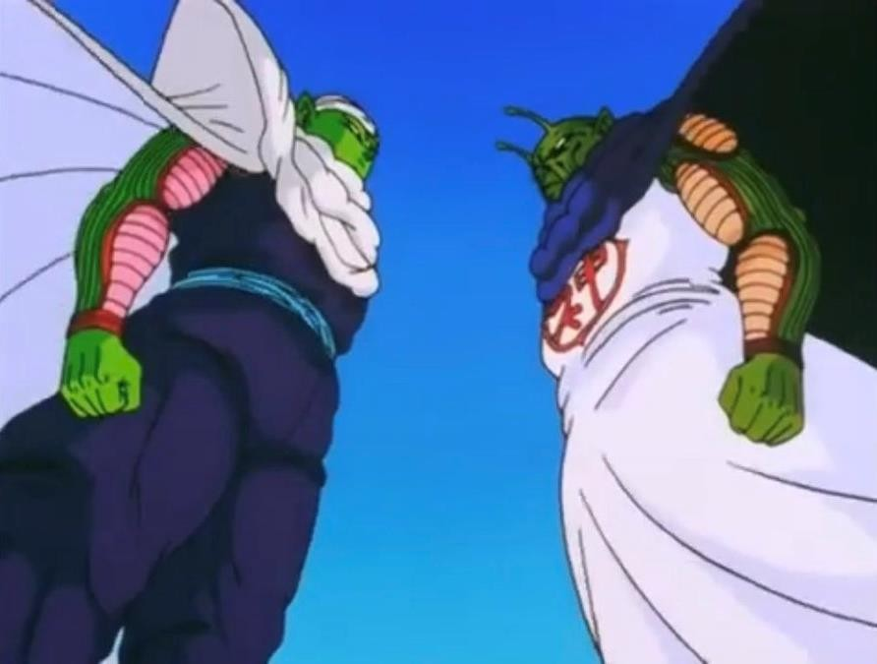
2. Definition of Life and Death
Natural Languages
Definition of Life
To continue changing and evolving
More than or equal to 2 live speakers
Communication between native speakers
Definition of Death
No more changes and updates
Less than or equal to only 1 speaker
No more communication between native speakers
We human beings are the alteregoisms of languages
→ If one dies, the other DOES. (Just like the relationship between Piccolo and the God in Dragon Ball Series)

Slide 19
2. Definition of Life and Death
Programming Languages
There are only two kinds of languages: the ones people complain about and the ones nobody uses. - Bjarne Stroustrup, creator of C++.
Be it because nobody is using it, nobody is hiring for it, or nobody is talking about it - based on the level of community engagement, the job market, and overall growth - some languages just aren't worth your time anymore.
Reference: ll.9-15, Justina H., Codementer

Slide 20
2. Definition of Life and Death
Programming Languages
Definition of Life
People are concerned about or interested in them
Complaints = Demand for them to be more usable
Ruby and Ruby on Rails are vigorously alive notwithstanding the yearly myth of death
Ruby has traditionally been updated to a major version in every Christmas
Developers keep using and enhancing them
Definition of Death
No one pays attention
No complaint = No demand
No maintenance = Lack in required features and full of security holes
No news is bad news.

Slide 21
3. Effects Caused by Death

Slide 22
3. Effects Caused by Death
Natural Languages
Orwell believed that if something is not sayable, it will not be thinkable.
In his novel, he told of a society that tried to limit language by getting rid of certain words(e.g., freedom or justice) and restricting the meaning of others.
The purpose was to make certain political ideas unsayable in the hope that they would become unthinkable.
Reference: p.61 ll.17-22, Michael L. Geis, Language and Communication

Slide 23
3. Effects Caused by Death
Natural Languages
Loss of the Way to Think
How do you think about and express hunger without the word
If a nation or society regulates the language, it means to force the people to lose the way they think about and articulate specific thoughts
Loss of Cultural Identities
Honorifics and euphemisms specific in Japanese language have been molded in the long history of Japan, for example
They have been thought, expressed and developed via loads of use via the language
It will absolutely be impossible for the Japanese specific concepts such as its two-faced culture and pleasantries to stay present

Slide 24
3. Effects Caused by Death
Programming Languages
Falls of the Market Values
"I developed i-Mode in Doja for a long time and have a high expertise of it" no more works
* i-Mode is a domestics web service for cellphones which used to be provided by Docomo
However, nothing is accurately predictable because JavaScript revived thanks to Ajax for Google Map using
asynchronous communications after it had been swallowed by the high trend of Flash
Increments of Development Costs
Maintenance costs
Implementation of lacking features from the scratch
Security patches
Transfer to another programming language or framework
etc.

Slide 25
4. Summary

Slide 26
4. Summary
Nature | Natural Languages | Programming Languages
Natural / Artificial | Naturally Born | 人工的
Written / Spoken | Written and Spoken | Written Only
Change and Evolution | Always | Constantly(It depends)
Reflection | Individuals, Communities, Societies, Cultures, Histories etc. | Thoughts and Belief of Developers (Creators and Committers)
Communication Tool? | 〇 | △
Definition of Life | To Continue Changing and Evolving | For People to Stay Interested
Definition of Death | Less than or Equal to 1 Native Speaker → No More Communication → No More Changes and Updates | None of anyone's business → No More Development → No More Changes and Updates
Effects Caused by Death | Loss of the Way to Think Loss of Cultural Identities | Falls of Market Values Increments of Development Costs

Slide 27
4. Summary
Supplementary Comments
On the one hand, it was difficult to find reliable references for programming languages because few people care about them unless they are highly evaluated and mentioned
On the other hand, it was much easier to find reliable references for natural languages because linguistics is established as an academic subject for them
Programming languages are born and raised in the capitalism era while natural languages have way long histories, so they die of the poor market values, not of their language natures
If Programming Linguistics is present…, what would it be like?

Slide 28
5. References

Slide 29
5. References
Sarah-Claire Jordan, What Causes the Death of a Language?
Last Accessed On: 23 October 2021
Justina H., Worst Programming Languages to Learn in 2018
Last Accessed On: 23 October 2021
Michael L. Geis, Language and Communication, Oxford, OUP, 2001
NTTドコモの公式開発ツールを使おう
Last Accessed On: 09 August 2021
@kujirahand, いまどきの JSプログラマーのための Node.jsと Reactアプリケーション, Tokyo, Socym Co,.Ltd., 2017

Slide 30
EOD

